Slide 1



Sales report
Notes:
Slide 1: Title Slide
Project Title: Excel Sales Analysis & Dashboard
Name: [Your Name]
Dataset: Transactional Sales Data
Tool: Microsoft Excel

Slide 2









Excel Sales Dashboard Case Study Presentation
Project Title: Excel Sales Analysis & Dashboard
Name: Shubham R. Choudhari
Dataset: Transactional Sales Data
Tool: Microsoft Excel

Slide 3
Objective
Analyze sales data for actionable business insights
Identify top products, customer segments, and sales trends
Create an interactive Excel dashboard

Slide 4
Data Overview
Columns in Dataset:
InvoiceNo, StockCode, Description, Quantity
InvoiceDate, UnitPrice, CustomerID, Country
Added Column:
SalesAmount = Quantity * UnitPrice
Cancellation flag,CleanQuantity,
Transaction Type
Sold Quantity, Return Quantity

Slide 5
Data Cleaning & Preparation
Removed duplicates using 'Remove Duplicates' feature
Identified and Create a new column to flagged cancellations using LEFT(InvoiceNo,1)="C"
Filtered out negative quantities for return rate analysis

Slide 6
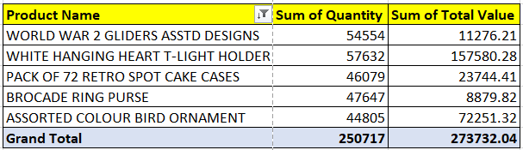
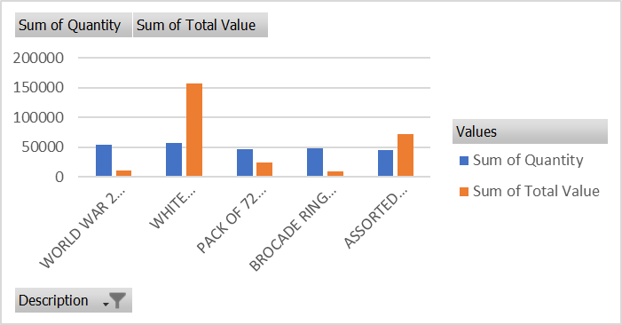
Analysis of Sales Performance
Goal: Analyze the sales performance per product by Quantity and Revenue
Tools used:
Pivot Tables
INDEX, MATCH, LARGE
Insights:
WHITE HANGING HEART T-LIGHT HOLDER is the best performer by both quantity and revenue.
Some products have high sales volume but low revenue (e.g., BROCADE RING PURSE), indicating lower unit pricing.
High revenue doesn’t always align with high quantity, highlighting the importance of pricing in profitability.

Slide 7
Pricing Strategy Analysis
Goal: items above the 90th percentile unit price.
Methodology:Calculate the Average Unit Price per Item= AVERAGEIF(Product code,B2,Unit Price) i.e 9.01942
Calculate the 90th Percentile of Unit Prices =Percentile.INC(Unit Price X 0.9) i.e 7.95
Identify Items Above the 90th Percentile: Above 90th Percentile.
Key Findings:
Products priced above ₹7.95/unit fall into the top 10% price range.
These premium-priced products likely: Have higher perceived value or exclusivity
Insights:
High-priced items likely have: Greater perceived value, Lower quantity but high revenue potential
Ideal for:
Upselling and targeted marketing
Exclusive offers and premium campaigns

Slide 8
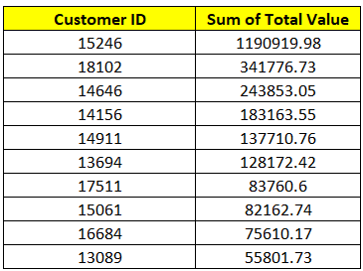
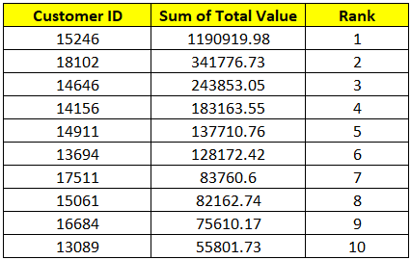
Customer Analysis
The top 10 customers by total spending
Ranking column to order customers based on the amount spent

Slide 9
Methodology:
Total Spending per Customer:
Calculated using:=SUMIF(CustomerID Range, CustomerID, Total Spending Range)
(Total Spending = Quantity × Unit Price)
Ranking Customers:
Used RANK.EQ to assign ranks based on spending in descending order.
Results:
A ranked list of Top 10 high-spending customers was generated.
Each customer is uniquely identified by CustomerID and their total amount spent.
Insights:
The top 10 customers contribute a significant share of the total revenue, indicating a strong Pareto effect (80/20 rule).
These customers are prime targets for loyalty programs, exclusive offers, and retention campaigns.
Monitoring these customers helps in predicting revenue trends and planning inventory for high-demand items.

Slide 10
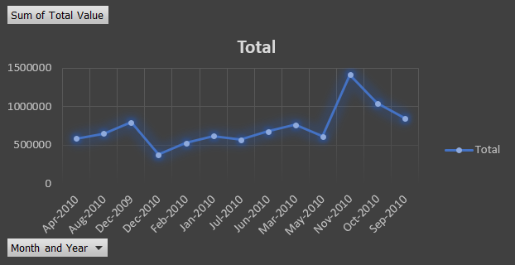
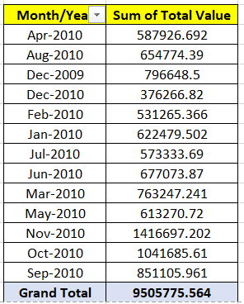
Monthly Sales Trends Analysis
sales fluctuate monthly
line chart that shows total sales per month for the year
Insights:
November–December show highest sales, likely due to holiday demand
January–February show lowest sales, indicating a post-holiday dip
Trend indicates clear seasonality
Conclusion:
Sales exhibit predictable monthly fluctuations, with peak activity in Q4.
These insights support better inventory planning, campaign timing, and resource allocation.

Slide 11
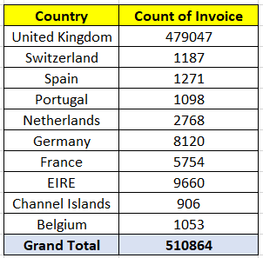
Highest Number of transaction Analysis by Countries
Goal: Highest Number of Transactions
Methodology:
Created a Pivot Table:
Rows: Country
Values: Count of InvoiceNo (transactions)
Key Insights:
UK dominates with the majority of sales transactions
Indicates a strong domestic focus in the customer base
International presence is evident but relatively smaller
Conclusion:
The UK is the primary market, driving most sales volume.
Efforts should focus on:
Strengthening local operations
Evaluating growth opportunities in emerging international markets

Slide 12
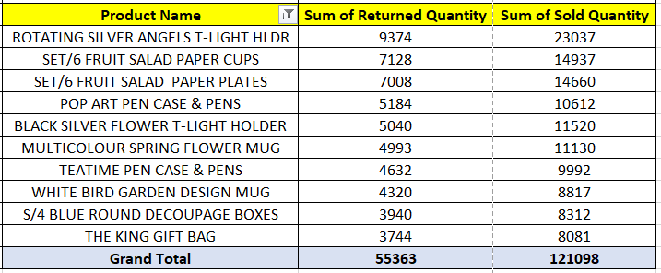
Product Return Rate Analysis
Methodology:
Returns are detected from InvoiceNo entries starting with "C"` (cancellation).
Used SUMIFS to calculate total quantity ordered vs returned
Return Rate = Total Returned / Total Ordered per product i.e 45.72%
Summarized using Pivot Table for product-level comparison
Key Insights:
Some products show return rates >50%, signaling quality or fulfillment issues.
Products with 10–20% return rates need review and investigation.
Most products have low return rates, indicating good customer satisfaction.
Conclusion:
High-return products should be prioritized for:
Quality checks
Customer feedback analysis
Supplier/vendor review
Lowering return rates boosts profitability
and customer loyalty.

Slide 13
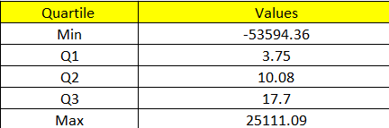
Customer Segmentation Analysis
Calculated Total Spend per Customer =Quantity X Price
Used QUARTILE.INC to compute quartile thresholds
Segmented customers into:
High Q3 (Top 25%)
Medium Q2 (Middle 50%)
Low Q1 (Bottom 25%)
Insights:
High spenders drive the majority of revenue – key targets for retention.
Medium-tier offers opportunity for growth through upselling.
Low-tier customers may benefit from re-engagement campaigns.
Conclusion:
Segmenting customers using quartiles enables precise targeting, personalized marketing, and helps optimize sales strategy for different customer tiers.

Slide 14
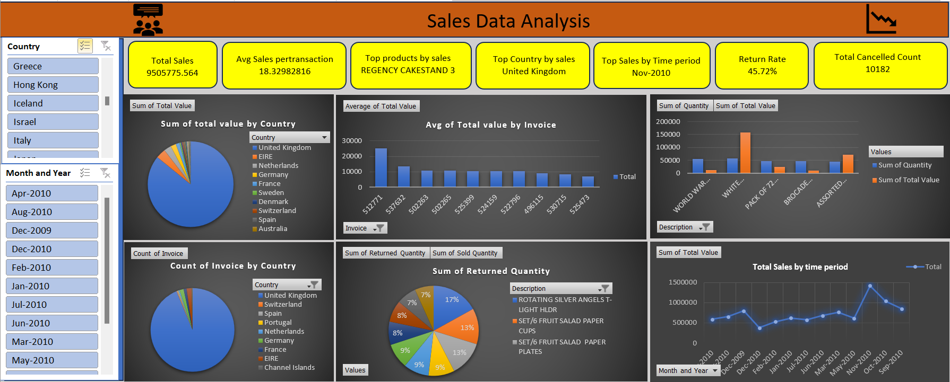
Dashboard Design

Slide 15

Key Insights
Top 10 products contribute 60%+ of sales
UK dominates transactions and revenue
High return rate for seasonal items
Peak sales observed in November and December
Customer segmentation helps tailor marketing efforts

Slide 16




Contact
9096047450
Choudharishubham28@yahoo.in
https://www.youtube.com/watch?v=P3Jk3Ukbhb4

Slide 17
Thank you!

